Slide 1



LSU Online Graduation Workshop Second Summer 2026
Clovier I. Torry – Assistant Dean, Academic Services & Professional Development Sean Lynam – Graduation Coordinator
Alexis Malbroux– Senior Academic Services Officer-Campus
Cassaundra L. Klinko– Academic Services Officer-LSU Online & Non-Degree
Linda K. Levy– Dissertation Editor
Kimber Peters– Thesis Editor

Slide 2

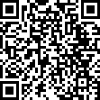
Application for Degree
 Application for Degree (AFD)
 Must be received before the AFD deadline-See LSU Online Graduate School Calendar:
https://www.lsu.edu/graduateschool/students/calendars.php
 All of the AFD forms can be found on the Graduate Student Forms page under the Online Students section: https://www.lsu.edu/graduateschool/students/grad_student_forms.php
 The AFD is submitted electronically, by clicking “Submit Form”.

Slide 3
Application for Degree (continued)
 The AFD tells the Grad School that the student plans to complete all degree requirements in the current module.
 The student will be entered in Workday Student as a degree candidate for that module.
 Each degree candidate’s record will be audited in order to make sure that all degree
requirements have been completed.
 Students who will not complete the degree requirements will be removed from the graduation list.
 Students who do not graduate will submit a new AFD for a future module.

Slide 4
Graduation List
 Graduation List Reports (“Degree Candidates by Type of Degree”)
are sent out to the departments at three points each module:
-After the AFD deadline
-1 to 2 weeks prior to degree conferral with a list of prospective deletions
-At the end of the module with all final deletions
 These lists should be reviewed each time they are sent out.
 In the Grad List Report, there is a separate section for each degree program.

Slide 5
Degree Only
 Students who have completed all degree requirements by the last day of the
previous module can choose “Degree Only” on the AFD form.
 This will put the student on a list of students who will be audited during the Degree Only processing period, which occurs during the first week of each module.
 If the student is approved for Degree Only a note will be placed in Workday indicating their approval as a Degree Only candidate.

Slide 6
Good Academic Standing
Good Academic Standing Policy – 3.0 Module and 3.0 LSU Cumulative
Implications for Graduate students not in good academic standing:
Student may receive a Scholastic Probation or Scholastic Drop.
Student will not be eligible to sit for a Master’s comprehensive exam, final project or capstone.
Student will not be eligible to graduate if they receive less than a 3.0 LSU Cumulative GPA the module in which they are graduating.

Slide 7

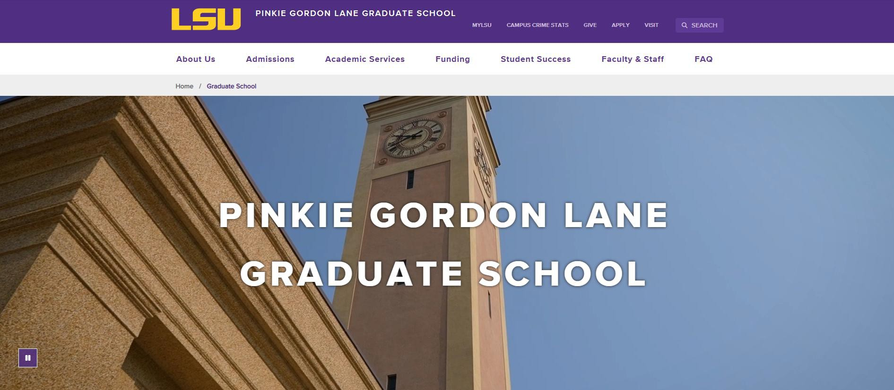
Enrolled Student Information
Graduate School Website : https://www.lsu.edu/graduateschool/index.php

Slide 8
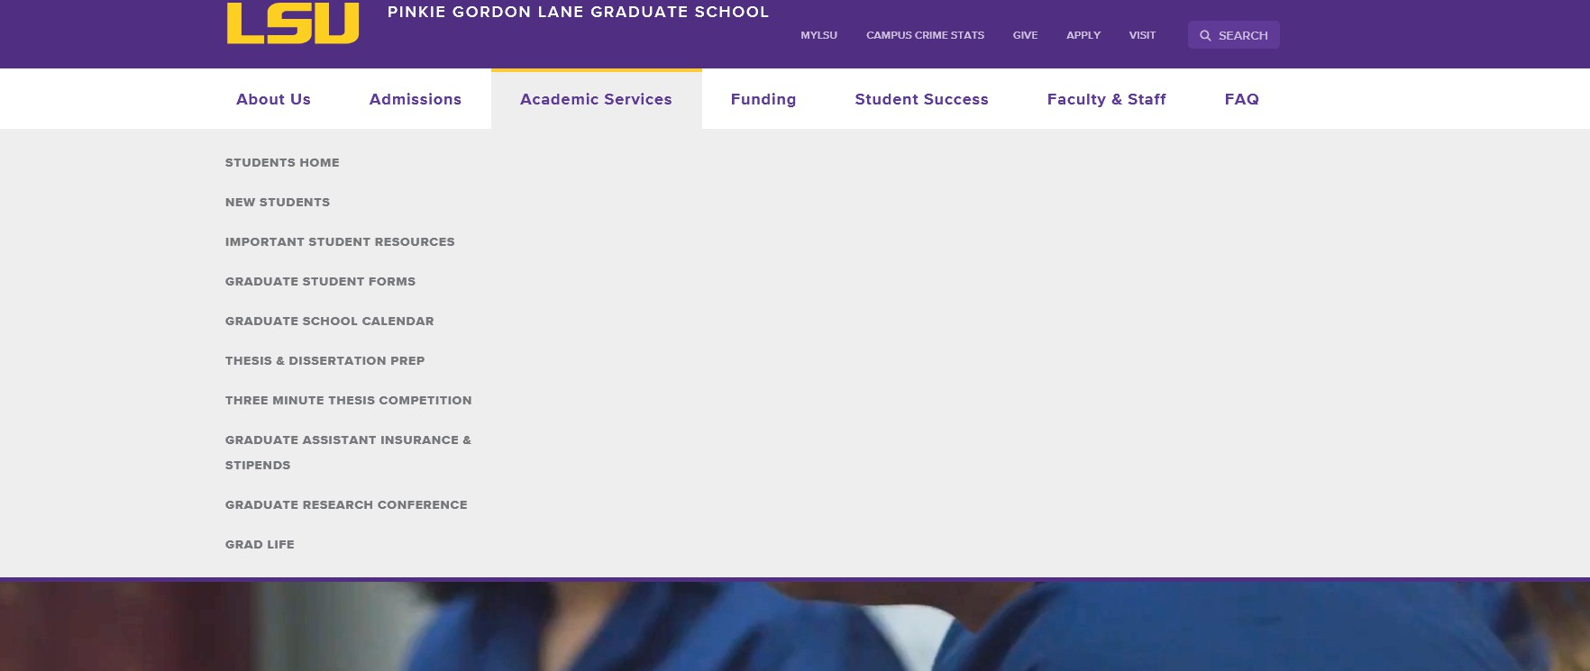
Enrolled Student Information(continued)

Slide 9
Request for Defense and Degree Audit
Important Deadlines
 Request for Final Defense/Audit Submission Deadline.
Typically due on the second day of classes for each module. For the Second Summer 2026 module, the date is July 7th
Request for Master’s Defense and Degree Audit: This is only applicable to you if your program has a
Master’s comprehensive exam, final project or capstone in which you have a committee that needs to be
evaluated by the Graduate School.
Online Master’s Program Degree Audit: This form is for Master’s programs which have coursework only requirements and no comprehensive exam, final project and/or capstone requirement.
Online Graduate Certificate Degree Audit: This form is for students seeking only a graduate certificate or adding an additional graduate certificate program to their Master’s program.
If you are pursuing more than one degree (dual degree), an audit needs to be completed for each degree. For example, a Master’s Degree and a Graduate Certificate. The appropriate audit should be submitted in whichever module you earn each degree.
NOTE: SAVE ALL SUBMISSION CONFIRMATION EMAILS!!!

Slide 10
Request for Defense and Degree Audit
(continued)
Advisory Committees
 Master’s Committee Makeup
 Minimum of three faculty members
 Committee Chair must be from the major department
 Master’s students must have at least one member with full graduate faculty status
Most LSU Online programs have already established committees. If you have any questions about your committee, reach out to your academic advisor to confirm who should be outlined for your committee on your Request for Master’s Defense and Degree Audit Form.
 Administrative Approvals
 These requests are submitted for potential committee members who do not have graduate faculty status and/or are not faculty employed at LSU
 Requests for AA are processed internally by the Academic Service Officer. The student/department should only list that person(s) name on the form and provide their CV. If there are issues, the Dean's Office will reach out to the academic department.

Slide 11
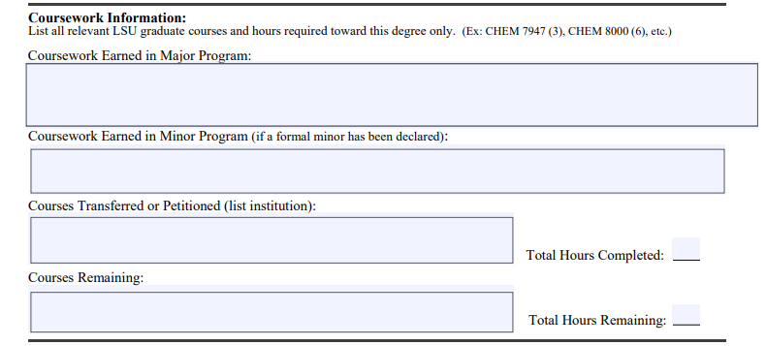
Degree Audit

Slide 12
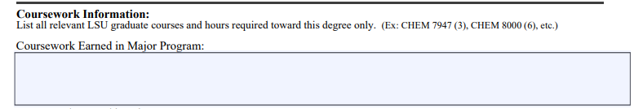
Coursework Earned in Major
Only list completed coursework needed for this degree
List course number and amount of hours.
For Example: CHEM 7947 (3)
Do not list courses that you are currently enrolled in

Slide 13

Courses Transferred
Any transfer work needs to be listed in the box above
Please list coursework in the same format – Ex. CHEM 7947 (3), CHEM 8000 (6)
List the University name next to the courses

Slide 14
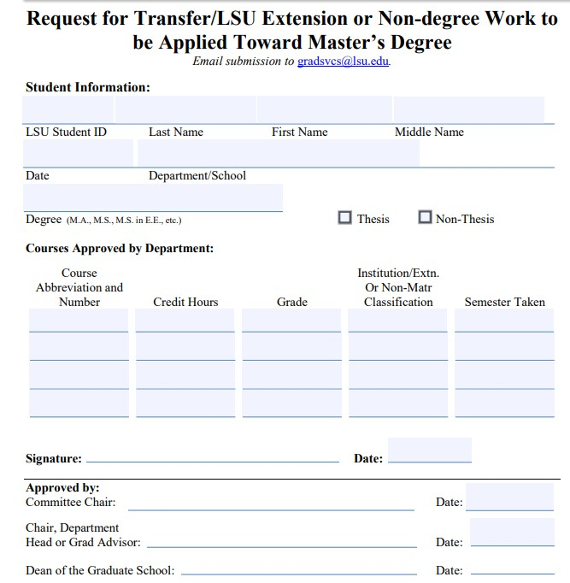
Transferring Coursework
Fill out Request for Transfer Credit Form
Signed by:
  Committee Chair
  Department Head or Grad Advisor
Send with your Request for Masters Defense or Degree Audit (if not already approved)

Slide 15
Transferring Credit Requirements
 Must be in Good Academic Standing (not on probation)
 Must have earned 9 hours of graduate credit in a degree program at LSU.
 Non-Matriculating Coursework taken at LSU must be transferred to be counted towards degree. A maximum of 6 credit hours at the 6000 level & above can be transferred from Non-Matriculating (Limited) classifications.
 All transfer work must have been taken for Graduate credit with a grade of a “B” or higher.
 A maximum of ½ of the coursework requirement can be transferred (including non-
matriculating credits).
 Transfer work must have been completed within 5 years of the time the student is able to submit the request.

Slide 16

Courses Remaining
Courses that are in-progress during the module you are defending/graduating go in this section
When you submit your Request for Final Defense or Audit, all coursework required for the degree must be completed or in-progress during the current module
Please list coursework in the same format – Ex. CHEM 7947 (3)

Slide 17
Requirements for Approval
Module and LSU Cumulative GPA must be above a 3.0
Must be registered for at least 1 credit hour in the semester the student
defends
Must meet coursework requirements for your degree
Committee must meet all requirements (if you are sitting for a comprehensive exam, final project and/or capstone)
All coursework must not be older than 5 years or it will need to be revalidated

Slide 18
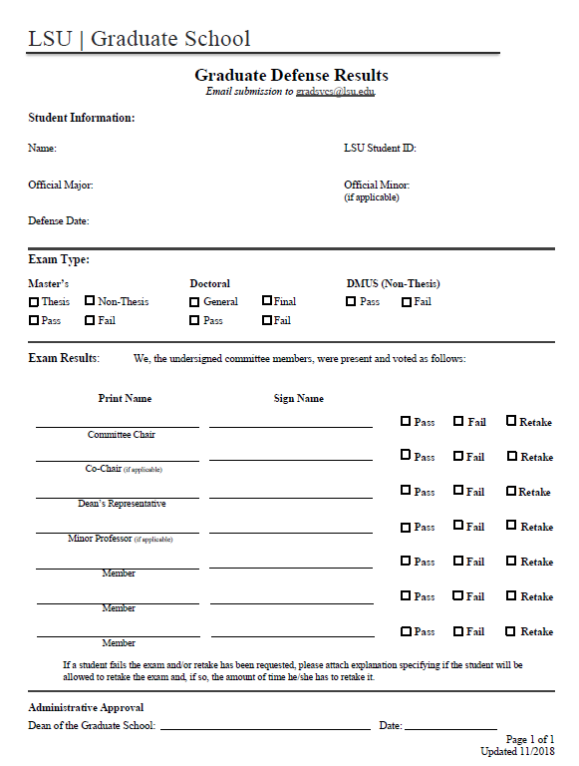
Graduate Defense Results

Slide 19
Path to Graduate Milestones
 With the transition to Workday Student, the location of various milestones will be different. The following milestones are available for all degree candidates to view in Workday Student
 Application for Degree
 Approval of Degree-Only Registration (if applicable)
 Approval of Degree Audit
 Defense/Exam Results (if applicable)

Slide 20
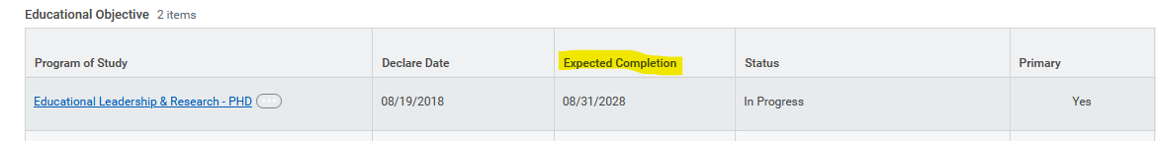
Milestone: Application for Degree
It will be located in Workday where your Program of Study is listed. Your EXPECTED COMPLETION DATE in Workday will update to designated degree conferral date for the degree(s) you indicated on your application for degree. This is how you will know that your application for degree has been received and processed. Degree conferral dates vary depending on which module you are graduating within.
Click here for information on understanding and navigating your student profile to find this information. Students also receive an immediate confirmation upon submission of their application for degree. The email will come from a noreply@formstack email account. Be sure to forward that confirmation email to your academic department for their records.
The conferral date for LSU Online 1st Summer Module is 07/07/2026
The conferral date for LSU Online 2nd Summer Module is 08/14/2026

Slide 21
Milestones Via Student Notes
The following milestones are viewable in the Note History section in Workday Student:
 Approval of Degree-Only Registration
 Approval of Degree Audit
Notes are manually input by our staff. Students will not receive an automatic notification in Workday once the note is placed.

Slide 22
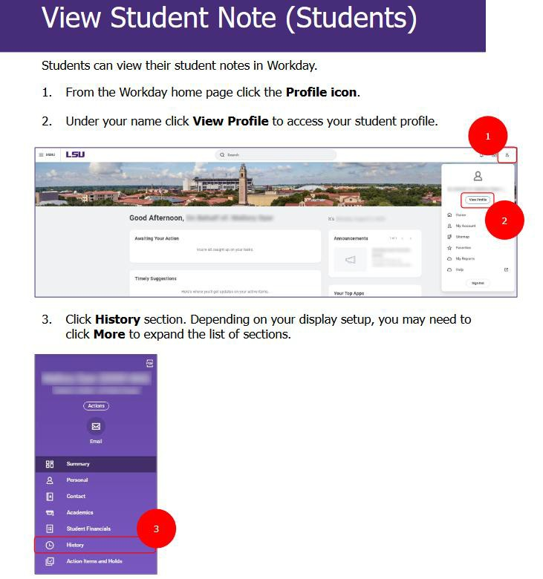
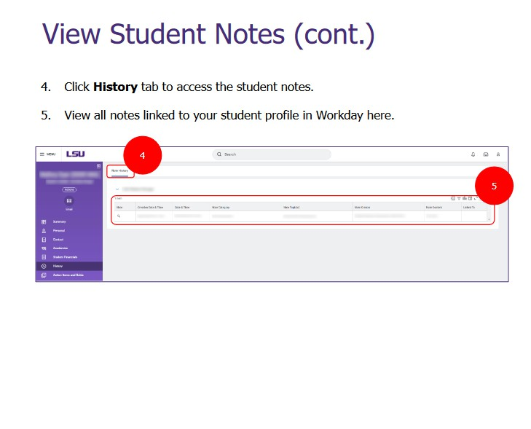
Milestones Via Student Notes (cont.)

Slide 23
Milestones Via External Records
The following Milestones are viewable on the External Records section in Workday Student:
 Graduate School Masters Comprehensive Final Exam
Applies to all LSU Online students sitting for a comprehensive exam, final project, or capstone.
This is for departments such as Public Administration, Education Leadership, Educational Technology, Higher Education, Environmental Science, and Industrial Engineering.
Records are manually input by our staff. Students will not receive an automatic notification in Workday once the record is placed.

Slide 24
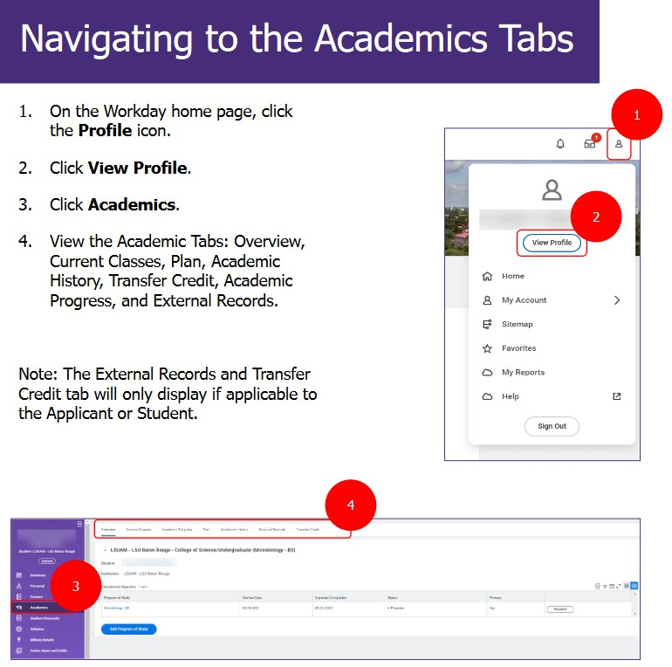
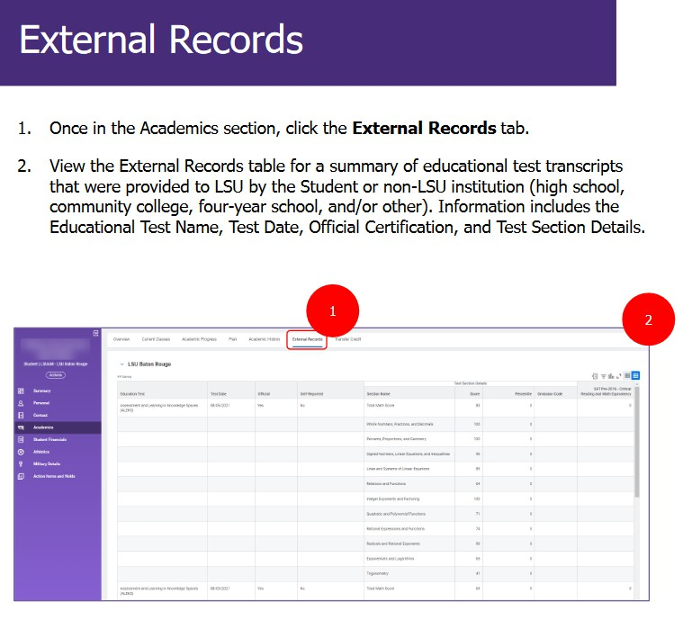
Milestones Via External Records (cont.)

Slide 25

Thank You!
 Please keep an eye out for emails from the Graduate School and visit our
social media platforms for important announcements and workshops!

