Slide 1

LSU Online New Student Orientation
June 30th, 2026-1:30-3:00 PM
Presenters:
Shannon Slaughter,
Senior Graduate Admissions Officer
Graduate Admissions-Pinkie Gordon Lane Graduate School
Cassaundra L. Klinko,
Academic Services Officer (LSU Online and Non-Degree)
Academic Services-Pinkie Gordon Lane Graduate School
Kristen S. Williams, PhD
Director of Graduate Student Success
Student Success-Pinkie Gordon Lane Graduate School

Slide 2
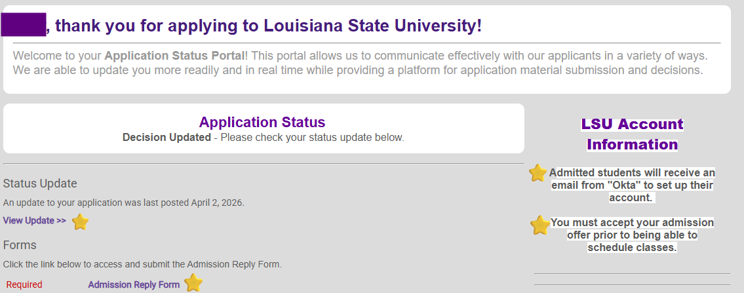
How to Access & Accept Your Admissions Offer
**To gain access to the LSU student systems, it is important that these steps are not skipped**
Log into your application portal (Slate) using the email address and password you submitted your application with.
You will see a status update. Click on it. You offer of admission letter will appear. After reading it, go back to this screen, and click on the "Admission Reply Form."

Slide 3
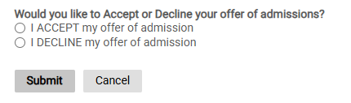
How to Access & Accept Your Admissions Offer (Continued)
3) When you click on the "Admission Reply Form", the form will appear, prompting you to accept or decline your Offer of Admission.
4) After accepting the offer, allow the system 24-48 hours to process and issue your LSU email address and Student ID number.
5) Please also complete the mandatory Identity Verification. You will receive an email, as well as a note on the application status portal, containing the same link that will take you to the verification page. This will require a form of government issued ID and information for matching/verification purposes.

Slide 4
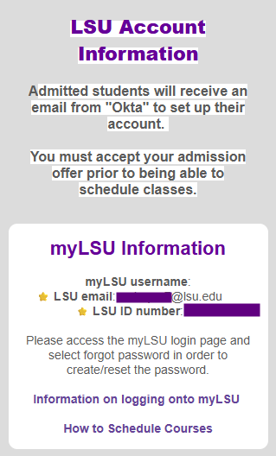
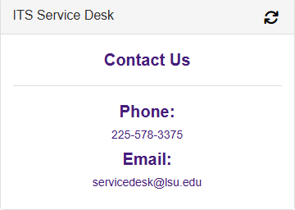
How to Gain Access to University Systems
(MYLSU, Email, Workday Student)
5) Once time is up, log back into your application portal, and your LSU credentials will be there.
6) Use LSU username/email address to set up your myLSU account, through the emailed instructions received from "Okta." This email would have gone to your personal email inbox (the email address you initially used to complete/sign in to your application portal with).
MyLSU is the "home base" that houses your student email, your Moodle, and your Workday Student Account, and much more!
If you experience technical issues setting up your account,
please contact the IT Service Desk.
Submit an ITS Ticket HERE!
https://itservice.lsu.edu/TDClient/30/Portal/Home/

Slide 5
How to Submit Transcripts & Clear Incomplete Admissions Documents
If you received Provisional Admission, Graduate Admissions has not yet received your Official Transcript(s) (with degree conferral(s) showing). If not received within your first module, a registration hold will be placed to prevent the scheduling of courses for the next module.
You can log back in to your application portal at any time to keep track of what has been or has not been received via the checklist.
LSU Online Transcript Ordering Service: Destiny Valle / Cherie Dalton (cdalto10@lsu.edu)
  If you opted in to the LSU Online Transcript service, we should already have your official transcript(s), which would grant regular admission (unless a degree or courses in progress).
  If you opted in and we do not have your official transcript(s), please contact Cherie Dalton via the email address listed above.
PGLGS Documents & Records: Gretchen Cade / Claudia Speyrer (gradtranscripts@lsu.edu)
  If you did not opt in to the Transcript service, there are a few other options for you to order your official transcripts to be sent to us.

Slide 6
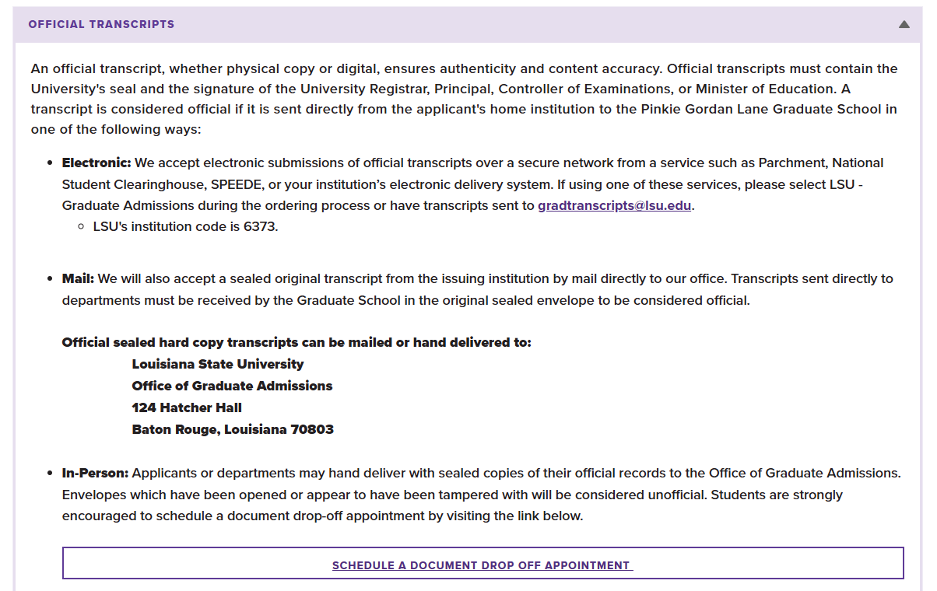
How to Submit Transcripts & Clear Incomplete Admissions Documents (Continued)
Helpful Links:
Admissions Requirements & Deadlines:
https://www.lsu.edu/graduateschool/admissions/requirements-deadlines.php
Book a Documents Appointment
(In-Person Drop Off ONLY):
https://applygrad.lsu.edu/portal/document_visit

Slide 7
Student Success Coach vs. Academic Advisor
As an LSU Online Student, you have many valuable resources available to you!
A Student Success Coach will be assigned to help guide you through the program and point you to correct resources. Upon admissions, your Student Success Coach will reach out to schedule a Welcome Call to orient you to LSU and assist you with processes such as accessing university systems and registering for courses. Your Student Success Coach will help direct and answer any questions you have during your time with LSU Online.
An Academic Advisor from your home department will also be assigned to help you in developing your course plan, timeline for graduation, and ensuring that you meet all degree requirements prior to applying for graduation. Your Academic Advisor can also assist with navigating process such as requesting a Leave of Absence or Institutional Withdrawal.
An Academic Services Officer from the Graduate School will oversee your time at LSU, assisting your Student Success Coach and Academic Advisor in helping you navigate any Graduate School policies or procedures. Your Academic Services Officer will be responsible for reviewing your degree eligibility once you submit your degree audit to ensure you meet all degree requirements prior to degree conferral.

Slide 8
How to Add Courses in Workday Student
There are three ways to register for courses via Workday Student:
Registering directly from Find Course Sections-LSUOnline
  This is by far the most common and easiest way to schedule. We will have step by step instruction in this presentation of this method.
  Make sure you use Find Course Sections-LSU Online, not Find Course Sections-LSUAM-this is for Campus students and you won’t be eligible to register for these courses. All LSU Online courses are denoted with an E for Online and any 4000 level section is denoted with a GE, G for Graduate and E for Online.
Registering from an Academic Plan
  You can work with your Academic Advisor to create a full course plan in your “Plan” section of “Academics” in Workday student. This will create a plan for multiple modules and can be created through your module of graduation.
  If all sections are open, it will prompt you to register for the appropriate sections and then you can register for all courses in the plan for each module.
  If a course is closed, you must revise your course plan before you register from the Academic Plan!
Registering from a Saved Schedule
  You can pre-save a schedule for a module in advance and once your registration appointment becomes available register for all open courses at once. You can create multiple saved schedules and name them for quick registration (For example: First Summer 2026 Schedule)
See Full Step-By-Step Registration Workday Student Course Registration Guide below:
https://uiswcmsweb.prod.lsu.edu/student/CoursesPlanningRegistration/ADV_007_STU_Course%20Registration%20for%20Students_Final.pdf

Slide 9
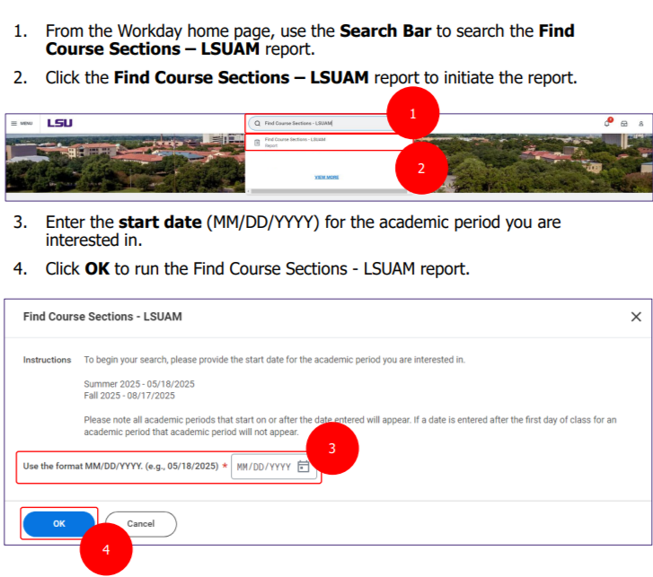
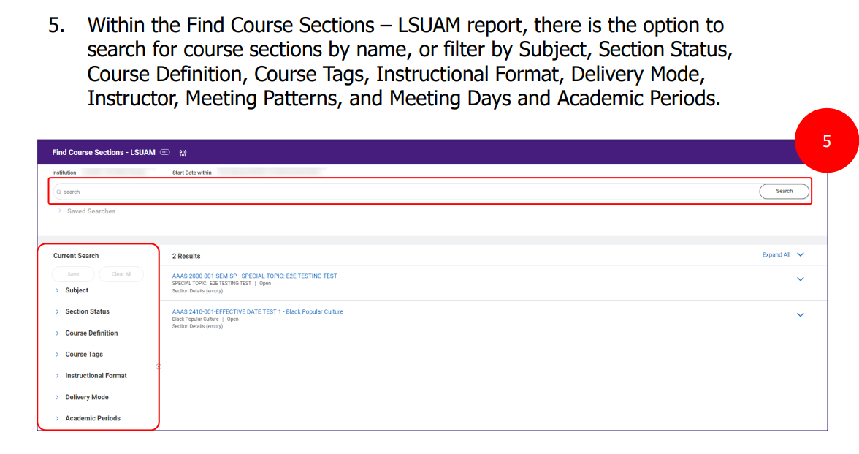
How to Add Courses using
Find Course Section-LSUOnline

Slide 10
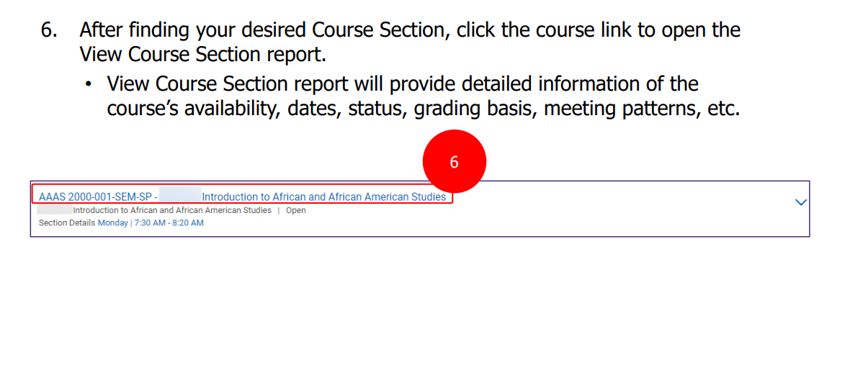
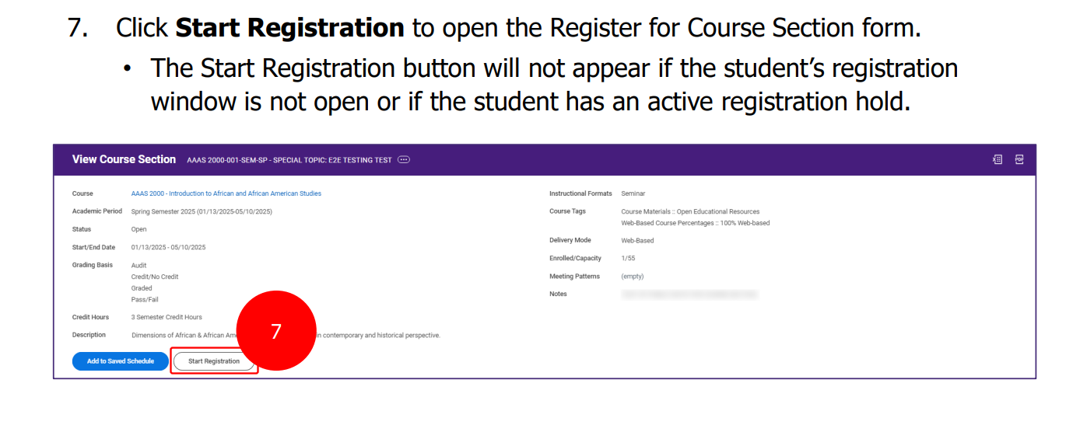
How to Add Courses using
Find Course Section-LSUOnline (Continued)

Slide 11
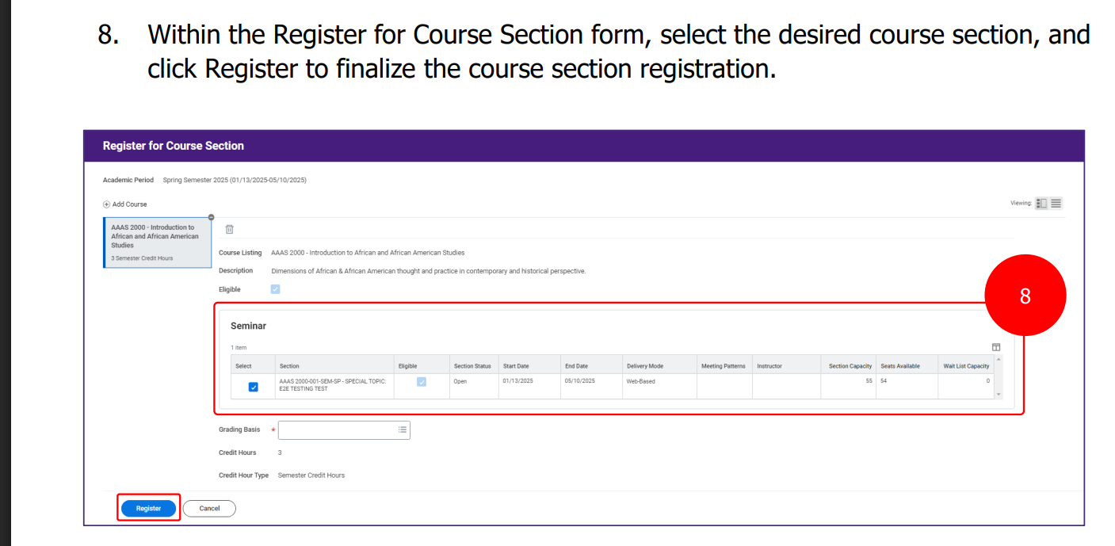
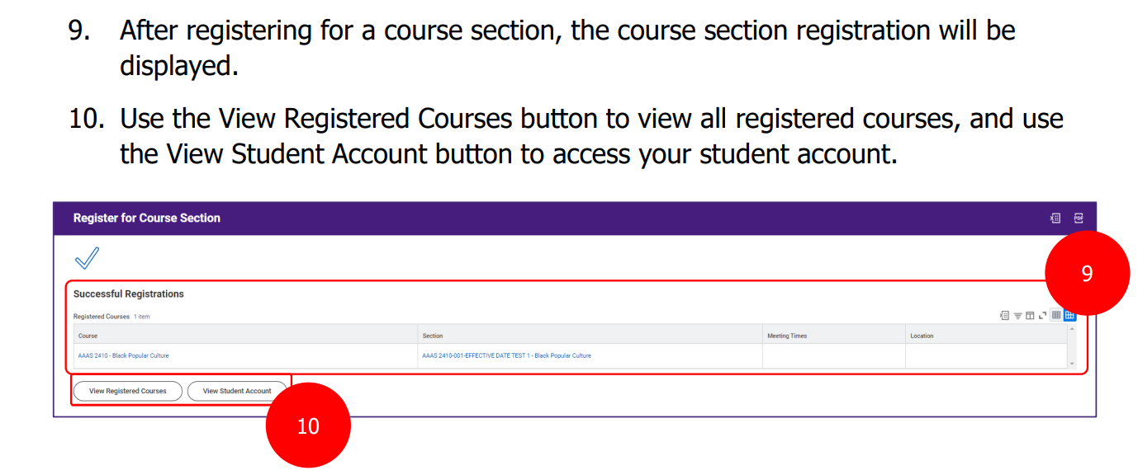
How to Add Courses using
Find Course Section-LSUOnline (Final Steps)

Slide 12
Successfully Completing Registration Steps
After initial registration for courses, you will need to complete the following registration steps each semester (Spring, Summer and Fall):
  Completing the Attendance Verification Questionnaire (sent via email)
  Completing your Financial Responsibility Acknowledgement in Workday Student (sent via Workday Student task)
  Making a payment, applying Financial Aid, and/or clearing any past-due balance
As a new student ONLY, you will also need to work with the Student Health Center to clear any Immunization requirements. If not completed, a hold may be placed on your account.
  Due to HIPPA, the Graduate School does not get updates on what is needed for these holds to be removed. Please reach out directly to the Student Health Center to submit required documents. Once completed, they will clear the holds.
You will get emails directly from the Bursar’s Office if you are missing one or multiple of these steps.
If you have questions about completing these steps, reach out to the Bursar’s Office directly.
If you have questions pertaining to Financial Aid, reach out to LSU Online Financial Aid directly.

Slide 13
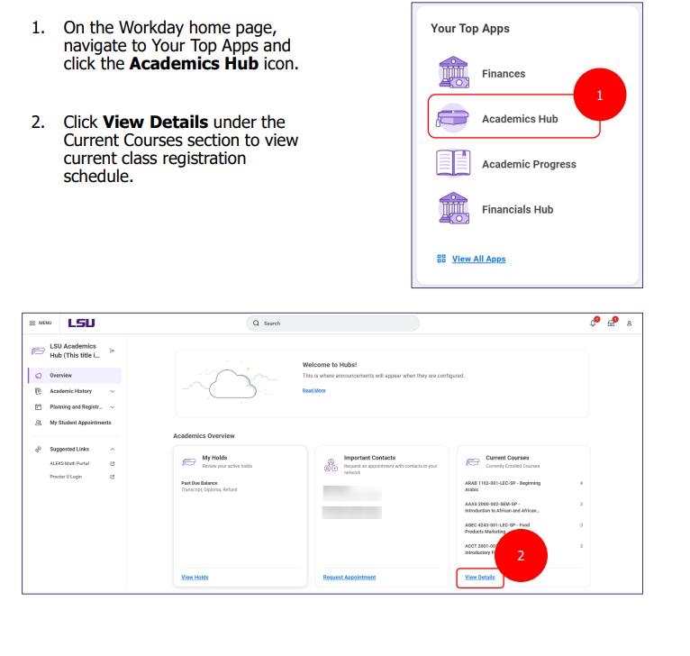
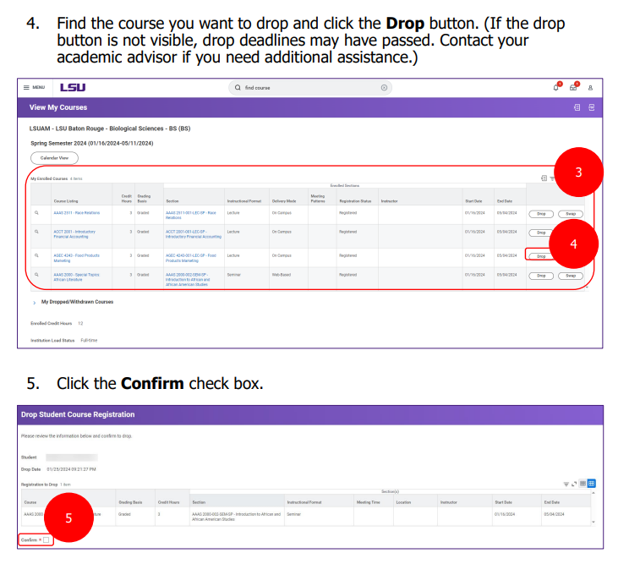
How to Drop or Withdraw Courses In Workday Student

Slide 14
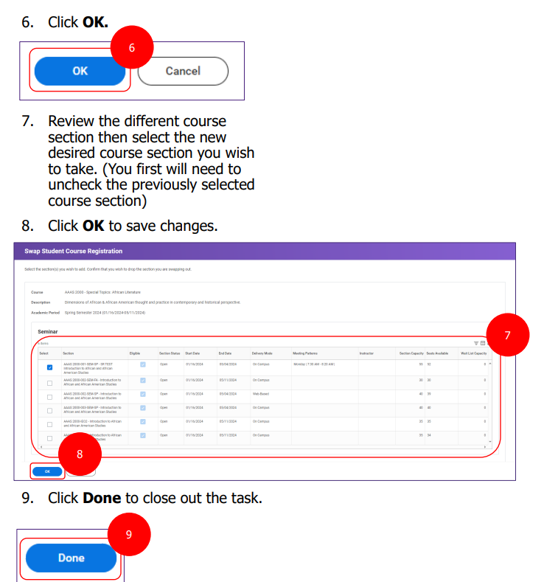
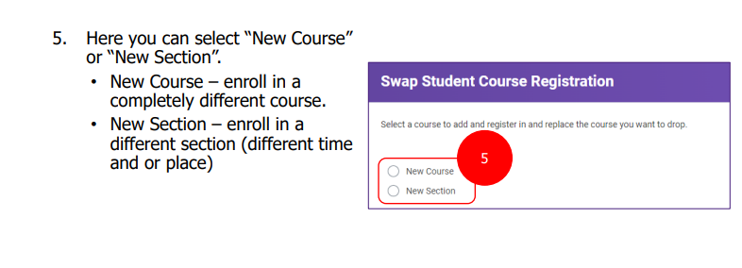
How to Swap Course Sections In Workday Student
To swap to a different course or different course section, you will complete the same steps as dropping, but select the swap option instead of drop. Once in you select the swap option, you will complete the following steps:

Slide 15
How to Request a Leave of Absence or Institutional Withdrawal
If you are dropping all courses in a semester (Spring, Fall, or Summer) and plan to return to courses within 1 year (6 modules), you will need to reach out to your Academic Advisor to submit a Leave of Absence in Workday Student.
  Once submitted, it will route to necessary offices for approval and the courses will be dropped or withdrawn once all approvals are completed. This can take a few days to process and your courses will still appear until the processes are completed.
    Note: A Leave of Absence can be approved after the deadline as long as your Academic Advisor submitted it by the applicable deadline. Refunds and drop/withdrawal status is based on the date the Leave of Absence was initiated, not the date all approvals are completed.
  If your Leave of Absence is denied, please reach out to your Academic Advisor to see who denied it and why. It may need to be re-submitted for you.
If you are dropping all courses in a semester (Spring, Fall, or Summer) and do not plan to return to LSU, you will need to reach out to your Academic Advisor to submit an Institutional Withdrawal in Workday Student.
  Please keep in mind that this option requires a new Graduate Admissions application be submitted.

Slide 16
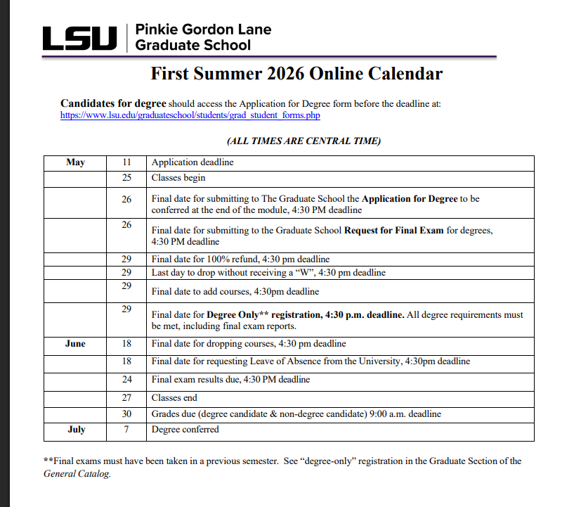
Deadlines for Dropping and Withdrawing
Each module there will be deadlines for dropping and/or withdrawing from the university. Please be mindful of these deadlines!
  You will need to drop by the Last Date to Add for 100% refund and no W.
  Anytime after the Last Date to Add, you will get 0% refund and a W on your transcript for the course.
  Please check with your funding source before dropping or withdrawing to ensure you understand any financial consequences.
Please see our Graduate School Academic Calendars on our website for each modules deadlines.
  https://www.lsu.edu/graduateschool/students/calendars.php
<---- See example calendar

Slide 17
How to Request a Change or Add Program of Study
If you want to change your Program of Study:
  Contact your Academic Advisor in your home department and the new department to see if the switch requires a new Graduate Admissions application.
  If it does not, both departments can sign and submit a Change of Department Form or Change of Degree Program Form (depending on the new program). Once received by the Graduate School, we will enter the change into Workday Student. It may take a few days to route for approval by all offices.
  If it does require a new Graduate Admissions application, proceed with submitting the appropriate Graduate Admissions application in accordance with the admissions deadlines for the module you want the switch to be effective.
If you want to add a Program of Study (i.e. Dual Degree):
  Contact your Academic Advisor in your home department to see if the switch is possible with your current degree program.
    Note: LSU Online students cannot simultaneously complete degree programs in different colleges. If LSU Online students want to complete multiple degrees that are housed under different colleges, they must first complete all degree programs under the first college and then transition to the new degree program.
    LSU Students who have graduated may declare another degree program for up to 1 year (6 modules) from the date of graduation without a new Graduate Admissions application, unless required by the new department.

Slide 18
Helpful University Resources
LSU Online Financial Aid
Email: lsuonlinefinaid@lsu.edu
Phone Number: 225-578-3103
Bursar’s Office
Email: bursar@lsu.edu
Phone Number: 225-578-3357
Registrar’s Office
Email: registrar@lsu.edu
Phone Number: 225-578-1686
LSU Olinde Career Center
Email: lisahibner@lsu.edu (Lisa Hibner is the LSU Online Career Coach)
Phone Number: 225-578-8038
Disability Services
Email: disability@lsu.edu
Phone Number: 225-578-5919
Student Advocacy & Accountability
Email: dossaa@lsu.edu
Phone Number: 225-578-4307
Office of Civil Rights & Title IX
Email: ocrandtix@lsu.edu
Phone Number: 225-578-4442
*See our full LSU Online Orientation Resource Guide for more information about these and other helpful resources!

Slide 19



Graduate Student Success
  Execute events, workshops, and cohort-based programs
  Facilitate professional, career, and academic development
  Serve as a centralized resource hub for graduate student support
  Collaborate with university divisions, student organizations, alumni, and other campus stakeholders to expand reach and impact
  Empower graduate students to achieve their full potential in research, scholarship, and professional advancement

Slide 20
University Partnerships
LSU Olinde Career Center
Center for Academic Success
LSU Division of Engagement, Civil Rights & Title IX
Communication Across the Curriculum
LSU Student Health Center
LSU Food Pantry
LSU Libraries
Office of Research & Economic Development
Office of Undergraduate Research
Office of Academic Affairs

Slide 21

Upcoming Events & Programs

Slide 22



Upcoming Events
Write On! (Interest form opens closes August 28)
Career Development Workshops
Tiger Skills Workshop Series

Slide 23
Graduate School Contacts for LSU Online Students
Graduate Admissions:
  Ijaha Crain
    Programs: Sports Management, Kinesiology, Social
    Work, Leadership and Human Resource Development
    Email: ijahacrain@lsu.edu
  Ryan Lawless
    Programs: All programs under College of Business,
    College of Coast and Environment, College of
    Engineering, College of Agriculture, and College of
    Human and Social Sciences
    Email: rlawle5@lsu.edu
  Shannon Slaughter
    Programs: Library & Information Science, Educational
    Technology, Educational Leadership, Higher Education
    Email: sslaughter@lsu.edu
Academic Services:
  Cassaundra L. Klinko
    All LSU Online Programs
    Email: gradofficer2@lsu.edu
    Phone Number: 225-578-0484
Student Success:
  Kristen S. Williams, PHD
    gradsuccess@lsu.edu
Please reach out if you have any questions as you navigate this new journey!
Geaux Tigers!
☺

